Slide 1
Developing an experimental platform for Human Robot Interaction based on human motion
Praveenkumar VASUDEVAN
European Master in Advanced Robotics
Supervisors : Gentiance VENTURE, Associate Professor, TUAT
Yannick AOUSTIN, Maître de Conférence à l'Université de Nantes
Co-supervisor : Armando TACCHELLA, Associate Professor, University of Genoa

Slide 2
Human Robot Interaction (HRI) and Social Robots
[Dautenhahn, 2007]
A Social robot should have the ability to interact with humans by adhering to certain social cues and rules. [Yan et al, 2014]
Engineering
Social
Science
Robotics
Psychology
Human
Robot
Interaction
Cognitive
Science
Artificial
Intelligence
Human Computer Interaction
Computer
Science

Slide 3
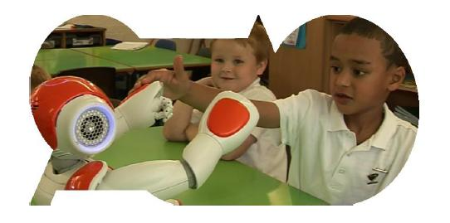
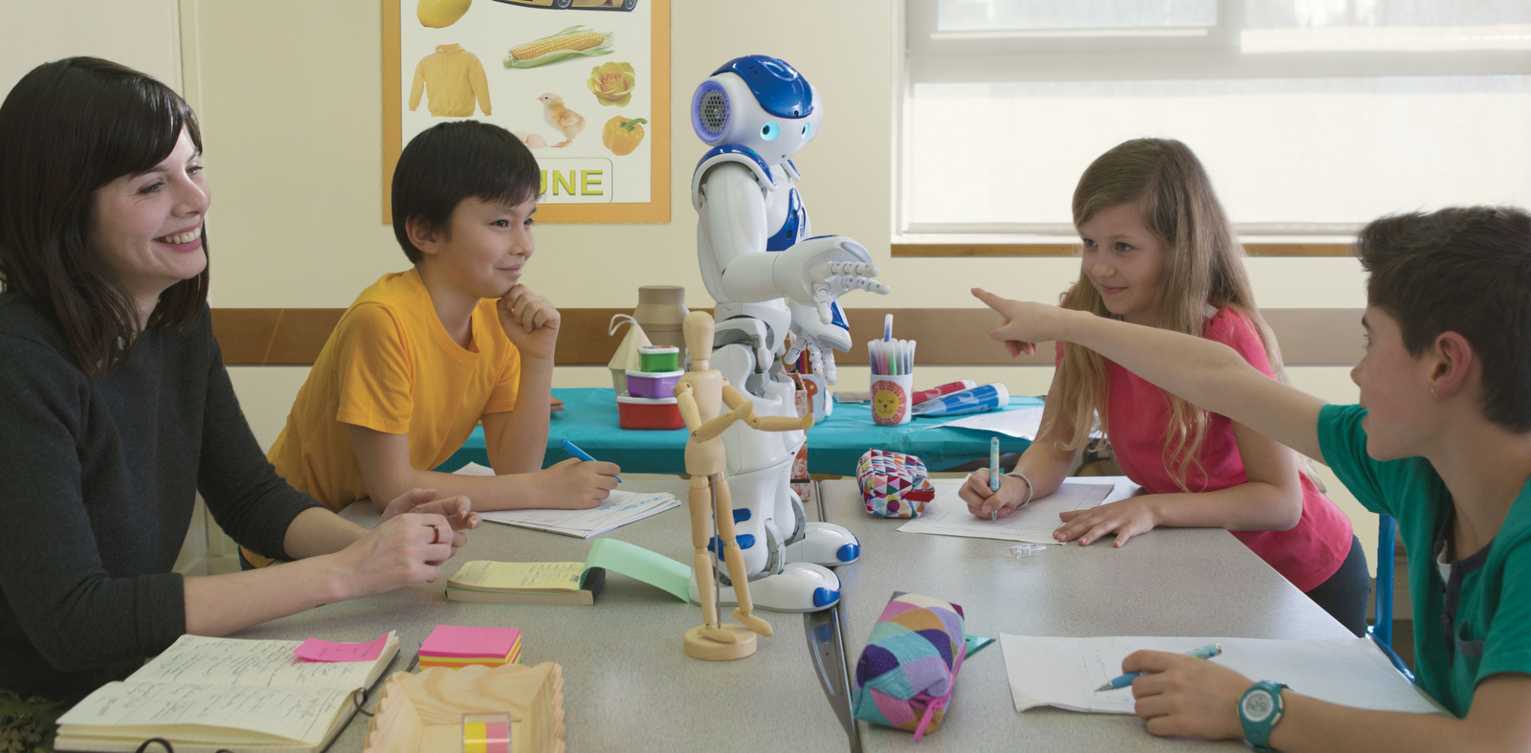
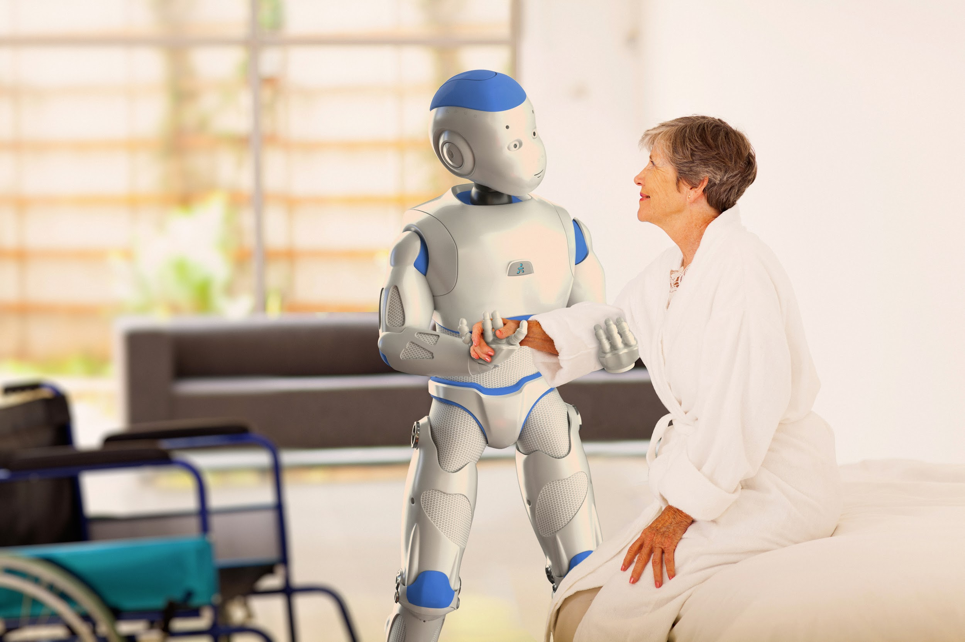
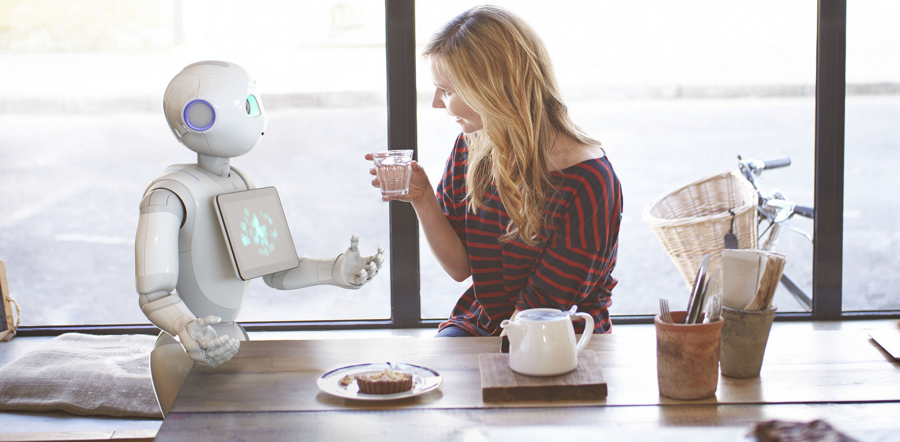
Where is HRI now?
ASKNao (Autism Solution)
Nao in Education
Romeo - Physical Interaction
Juliette (Pepper) - Casual interaction
Images from Aldebaran (https://www.aldebaran.com/en)

Slide 4
Motivation(s)
Humans interacting with intelligent Robots has been seen as a potential game changer in the future.
Human motion (Non-verbal communication) is rich in information and understanding it is very important to improve the interaction.
Motion conveys intention, health, emotion etc.,
Existing tools for designing HRI scenarios and robot behaviors are not scalable and requires skilled roboticians’ assistance
Goal : To develop an experimental platform which
Facilitate interaction based on human motion
Easy to design and execute interaction scenarios

Slide 5
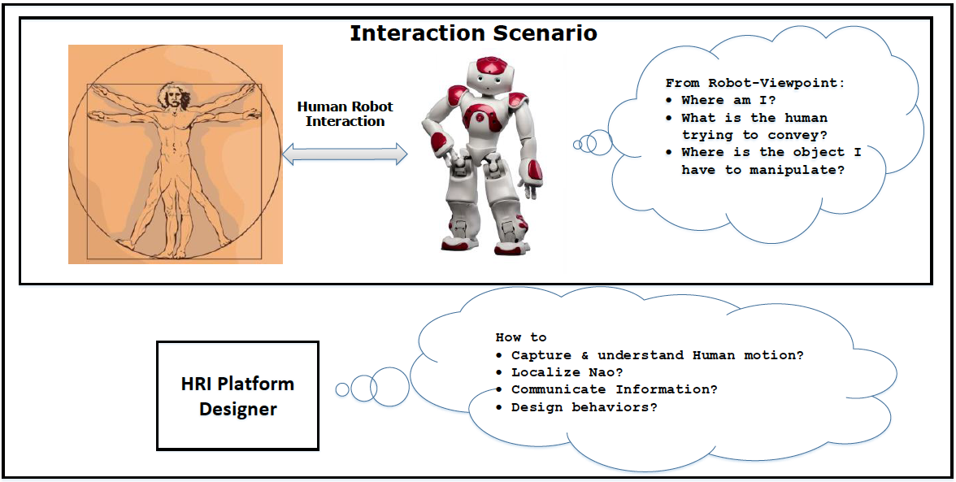
Problem Statement(s)

Slide 6
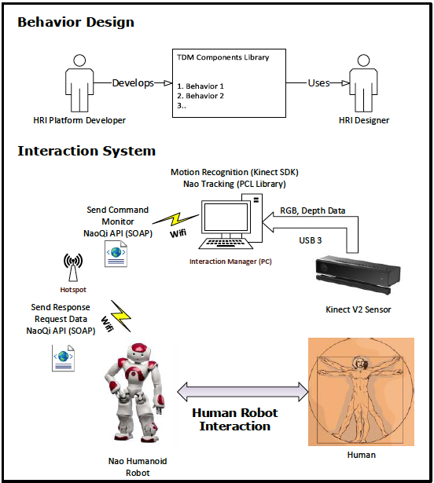
Summary on Bibliographic study
Motion capture:
Stereophotogrammetric system, Monocular Cameras, IMU, RGB-D Cameras (Kinect V2)
Localization:
Marker based approaches, Point cloud library algorithms (Monte carlo localization)
Designing behaviors:
ROS, Choregraphe, Task Description Language, URBI, Microsoft Robotics Developer studio, Target Drives Means?
Evaluation techniques:
Self-assessment, Interviews, Behavioral measures, Psychophysiolgy measures, Task performance metrics
Initial Proposal

Slide 7
Platform infrastructure design
Goals
Distributed nodes
Achieved using ZeroMQ (TCP, UDP, IPC)
Transparent messaging protocol that enables good interoperability
Google protocol buffers. Many primitive messages are imported from Gazebo
Visualization capability
OpenRAVE – Open source robotics planning / simulation framework
Visual Programming/ Natural language description of behaviors
Under investigation
Software design concept
Behavior designer
Behavior Execution engine

Slide 8
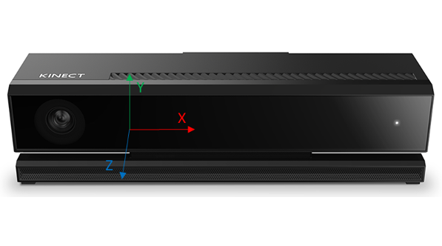
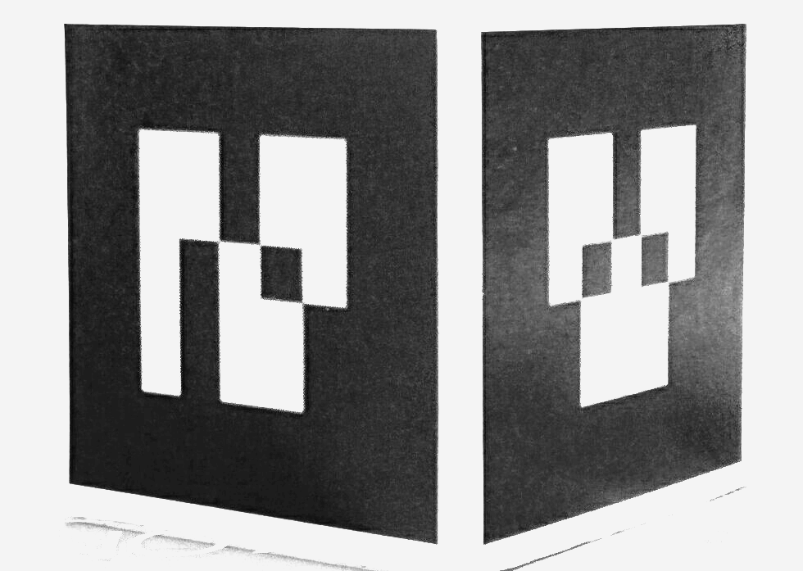
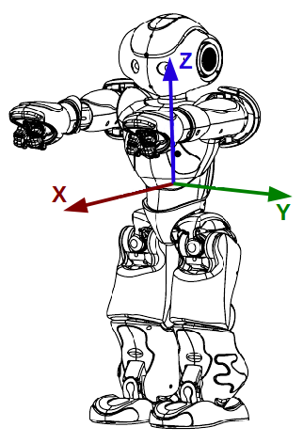
Localization
6D Pose of robot
Algorithm
latex algo
init: marker size, cube size, marker top frame pose mapping, torso to head kinematic model
do:
sensor data process
compute top frame in world coordinate
compute top frame in torso coordinate (head joint,yaw)
compute torso in world coordinate
end
Localization
Robot interface
Kinect Data capture
USB3
Ethernet
Visual Link

Slide 9
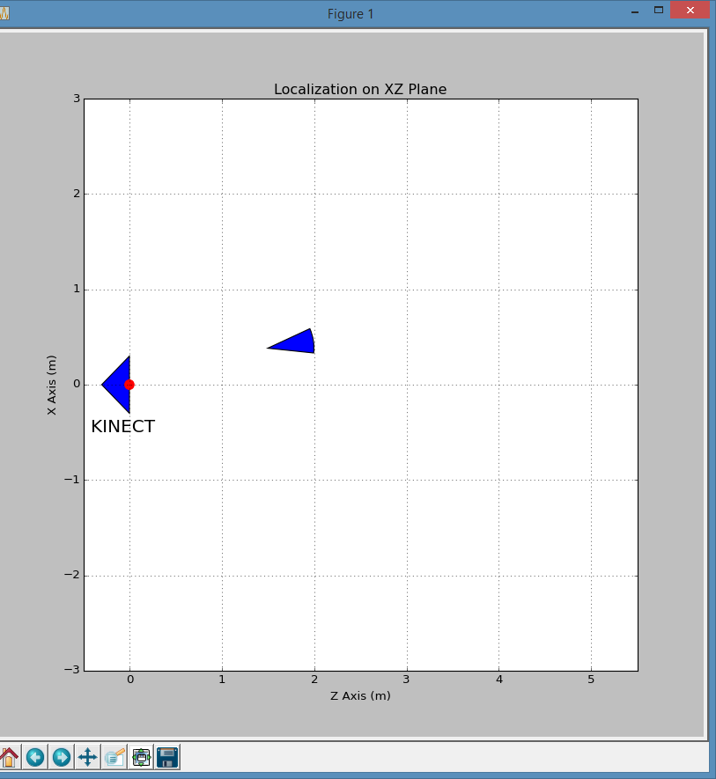
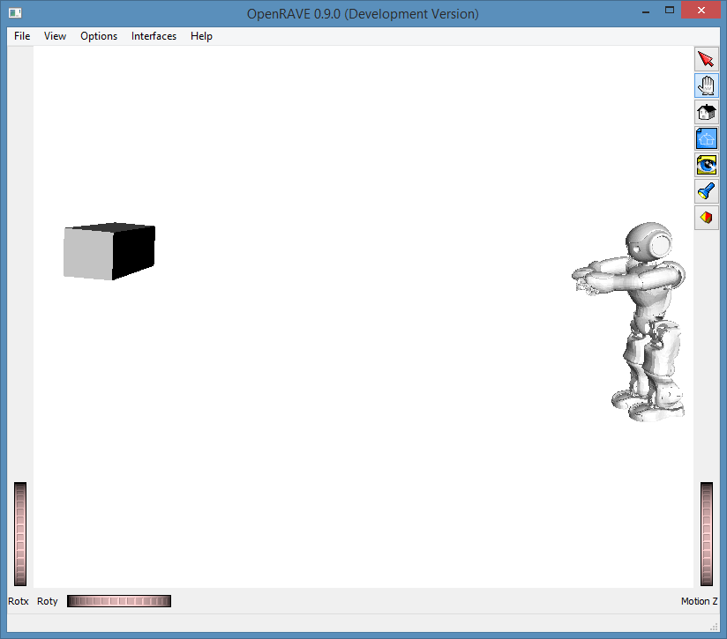
Localization - Results
Localization in XZ Plane (Top view)
Localization in 3D
KINECT

